Slide 1



Noida Institute of Engineering and Technology, Greater Noida
Python Web Development with Django
Unit: V
Deploying Django Web Application on Cloud
SHALINI SHROTRIYA
(Asst. Professor)
IT Department
Course Details (B. Tech. 5th Sem)

Slide 2
Faculty Introduction
Name | Shalini Shrotriya
Qualification | M. Tech. (Computer Engineering)
Designation | Assistant Professor
Department | Information Technology
Total Experience | 21 years
NIET Experience | 4 months
Subject Taught | Natural Language processing, Full Stack

Slide 3
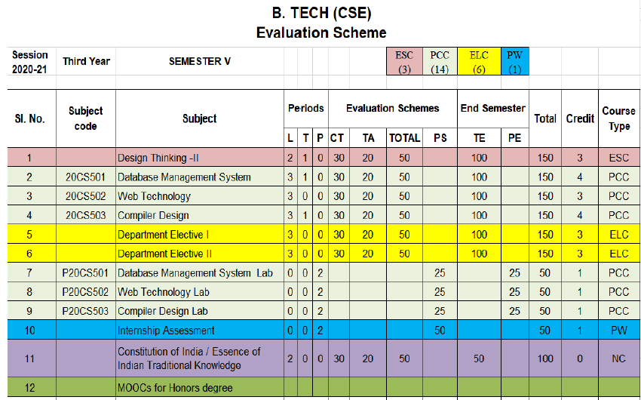
Evaluation Scheme
Python Web development with Django (Elective I)
Design Pattern (Elective II)

Slide 4
Syllabus
UNIT-I: Python libraries for web development
Collections-Container datatypes, Tkinter-GUI applications, Requests-HTTP requests, BeautifulSoup4-web scraping, Scrapy, Zappa, Dash, CherryPy, TurboGears, Flask, Web2Py,
Bottle, Falcon, CubicWeb, Quixote, Pyramid.

Slide 5
Syllabus
UNIT-II: Introduction to Django Framework
Understanding Django environment, Features of Django and Django architecture, MVC &MTV, Urls and Views, Mapping the views to URLs, Django Template, Template inheritance Django Models, Creating model for site, Converting the model into a table, Fields in Models, Integrating Bootstrap into Django, Creating tables, Creating grids, Creating carousels.

Slide 6
Syllabus
UNIT-III: Integrating Accounts & Authentication on Django
Introduction to Django Authentication System, Security Problem & Solution with Django Creating Registration Form using Django, Adding Email Field In Forms, Configuring email settings, Sending emails with Django, Adding Grid Layout On Registration Page, Adding Page Restrictions, Login Functionality Test and Logout.

Slide 7
Syllabus
UNIT-IV: Connecting SQLite with Django
Database Migrations, Fetch Data From Database, Displaying Data On Templates, Adding Condition On Data, Sending data from url to view, Sending data from view to template, Saving objects into database, Sorting objects, Filtering objects, Deleting objects, Difference between session and cookie, Creating sessions and cookies in Django.

Slide 8
Syllabus
UNIT-V: Deploying Django Web Application on Cloud
Creating a functional website in Django, Four Important Pillars to Deploy, Registering on Heroku and GitHub, Push project from Local System to GitHub, Working with Django Heroku
Working with Static Root, Handling WSGI with gunicorn, Setting up Database & adding users

Slide 9
Branch Wise Application
1. Real time web analytics
2. Digital Advertising
3. E-Commerce
4. Publishing
5. Massively Multiplayer Online Games
6. Backend Services and Messaging
7. Project Management & Collaboration
8. Real time Monitoring Services
9.Live Charting and Graphing
10. Group and Private Chat

Slide 10
Course Objective
In this semester, the students will
Study how to shows relationships and interactions between frontend &backend
Study to speed up the development process by providing well-tested, proven development/design paradigms.
Select a specific framework for the development of a given website or webapp.
Analyzing and creating a functional website in Django and deploy Django Web Application on Cloud.

Slide 11
Course Outcomes (COs)
At the end of course, the student will be able to:
CO1 : Apply the knowledge of python programing that are vital in understanding Django application
CO2 : Demonstrate web application framework (Django) to design and implement dynamic website
CO3 : Implementing and analyzing the concept of Integrating Accounts & Authentication on Django
CO4 : Understand the impact of web designing by database connectivity with SQLite
CO5 : Analyzing & Creating a functional website in Django and deploy Django Web Application Cloud

Slide 12
Program Outcomes (POs)
Engineering Graduates will be able to:
PO1 : Engineering Knowledge
PO2 : Problem Analysis
PO3 : Design/Development of solutions
PO4 : Conduct Investigations of complex problems
PO5 : Modern tool usage
PO6 : The engineer and society

Slide 13
Program Outcomes (POs)
Engineering Graduates will be able to:
PO7 : Environment and sustainability
PO8 : Ethics
PO9 : Individual and teamwork
PO10 : Communication
PO11 : Project management and finance
PO12 : Life-long learning

Slide 14

COs - POs Mapping
CO.K | PO1 | PO2 | PO3 | PO4 | PO5 | PO6 | PO7 | PO8 | PO9 | PO10 | PO11 | PO12
CO1 | 2 | 2 | 2 | 3 | 3 | - | - | - | - | - | - | -
CO2 | 3 | 2 | 3 | 2 | 3 | - | - | - | - | - | - | -
CO3 | 3 | 2 | 3 | 2 | 3 | - | - | - | - | - | - | -
CO4 | 3 | 2 | 3 | 2 | 3 | - | - | - | - | - | - | -
CO5 | 3 | 2 | 3 | 3 | 3 | - | - | - | - | - | - | -
AVG | 2.8 | 2.0 | 2.8 | 2.4 | 3.0 | - | - | - | - | - | - | -

Slide 15
Program Specific Outcomes(PSOs)
S. No. | Program Specific Outcomes (PSO) | PSO Description
1 | PSO1 | Understand to shows relationships and interactions between classes or objects of a pattern.
2 | PSO2 | Study to speed up the development process by providing well-tested, proven development
3 | PSO3 | Select a specific design pattern for the solution of a given design problem
4 | PSO4 | Create a catalogue entry for a simple design pattern whose purpose and application is understood.

Slide 16
COs - PSOs Mapping
CO.K | PSO1 | PSO2 | PSO3 | PSO4
CO1 | 3 | - | - | -
CO2 | 3 | 3 | - | -
CO3 | 3 | 3 | - | -
CO4 | 3 | 3 | - | -
CO5 | 3 | 3 | - | -

Slide 17
Program Educational Objectives (PEOs)
Program Educational Objectives (PEOs) | PEOs Description
PEOs | To have an excellent scientific and engineering breadth so as to comprehend, analyze, design and provide sustainable solutions for real-life problems using state-of-the-art technologies.
PEOs | To have a successful career in industries, to pursue higher studies or to support entrepreneurial endeavors and to face the global challenges.
PEOs | To have an effective communication skills, professional attitude, ethical values and a desire to learn specific knowledge in emerging trends, technologies for research, innovation and product development and contribution to society.
PEOs | To have life-long learning for up-skilling and re-skilling for successful professional career as engineer, scientist, entrepreneur and bureaucrat for betterment of society.

Slide 18
Result Analysis(Department Result & Subject Result & Individual result
Name of the faculty | Subject code | Result % of clear passed

Slide 19
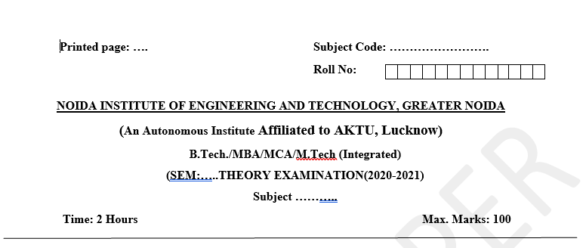
Pattern of Online External Exam Question Paper (100 marks)

Slide 20
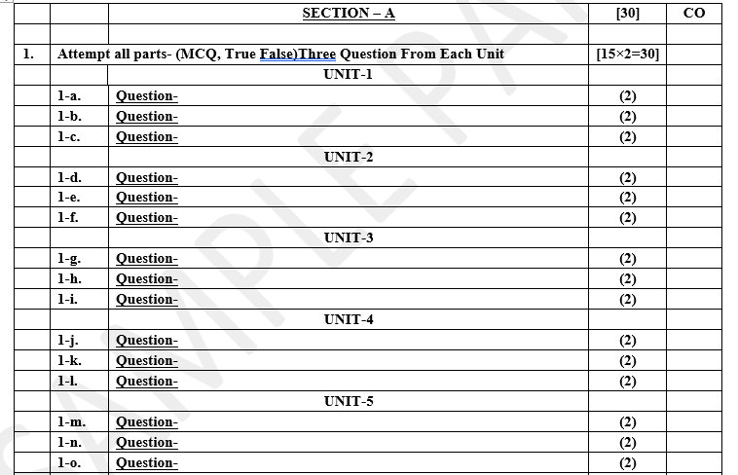
Pattern of Online External Exam Question Paper (100 marks)

Slide 21
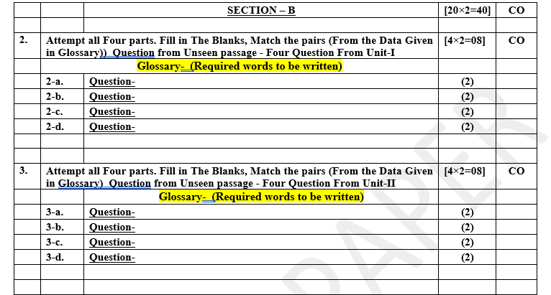
Pattern of Online External Exam Question Paper (100 marks)

Slide 22
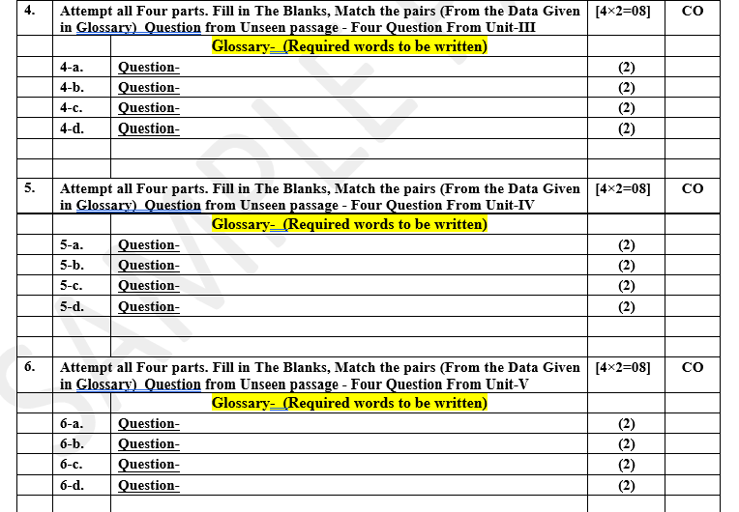
Pattern of Online External Exam Question Paper (100 marks)

Slide 23
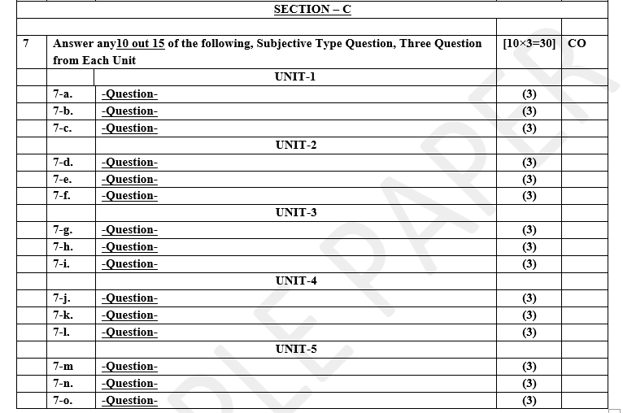
Pattern of Online External Exam Question Paper (100 marks)

Slide 24
Prerequisite / Recap
Student should have knowledge of HTML , CSS and JavaScript .
Students should have good knowledge of Python Programming and Python coding experience.
knowledge of Computer and basic skill.
Good problem solving Skill .

Slide 25
Brief Introduction about the Subject with videos
YouTube /other Video Links
https://youtu.be/eoPsX7MKfe8?list=PLIdgECt554OVFKXRpo_kuI0XpUQKk0ycO
https://youtu.be/tA42nHmmEKw?list=PLh2mXjKcTPSACrQxPM2_1Ojus5HX88ht7
https://youtu.be/8ndsDXohLMQ?list=PLDsnL5pk7-N_9oy2RN4A65Z-PEnvtc7rf
https://youtu.be/QXeEoD0pB3E?list=PLsyeobzWxl7poL9JTVyndKe62ieoN-MZ3
https://youtu.be/9MmC_uGjBsM?list=PL3pGy4HtqwD02GVgM96-V0sq4_DSinqvf

Slide 26
Unit V Content
Creating a functional website in Django.
Four Important Pillars to Deploy.
Registering on Heroku and GitHub, Push project from Local System to GitHub.
Working with Django Heroku.
Working with Static Root.
Handling WSGI with gunicorn.
Setting up Database & adding users.

Slide 27
Unit V Objective
In Unit V, the students will be able to find
Define Four Important Pillars to Deploy.
How to Registering on Heroku and GitHub .
Working with Django Heroku.
What is WSGI and relationship with gunicorn.
Setting up Database & adding users.

Slide 28
Topic Objective
Topic : Collection— Creating a functional website in Django
In this topic, the students will gain , The idea of Having a website helps grow an online presence, whether that be your personal blog or business, by connecting you with a broader audience. A website can also become a platform for sharing your opinions and skills, creating opportunities for personal or work-related projects.

Slide 29
Creating a functional website in Django
Having a website helps grow an online presence, whether that be your personal blog or business, by connecting you with a broader audience. A website can also become a platform for sharing your opinions and skills, creating opportunities for personal or work-related projects.
This lecture will help you turn your website idea into a fully-functional website – pick a suitable platform, get a web hosting plan, and choose a memorable domain name. We’ll also give you tips on how to optimize it.
Before creating your first website, you need to understand these three essential elements – what’s a website building platform, web hosting, and a domain name.

Slide 30
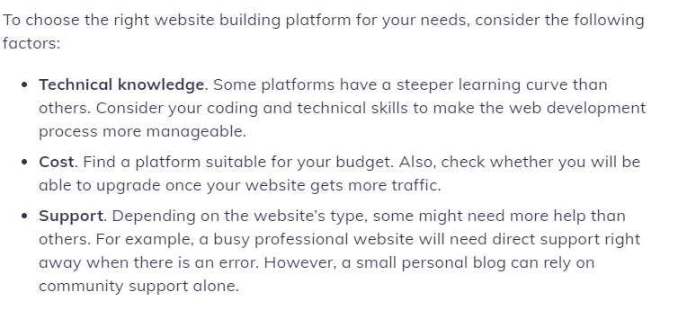
Creating a functional website in Django

Slide 31
Four Important Pillars to Deploy
Pillar One: Technology
Front and backend development processes can drastically affect the overall performance of your site. Visitors are mostly affected by frontend site performance, e.g. the way that your site performs when a user goes to the homepage or clicks on an internal link. It’s the most visible indicator of site performance, because it’s pretty obvious if a user is staring at a blank screen for 5-10 seconds, that a site isn’t performing at its peak.
When you change a piece of tech, add a new feature, or even update an existing plugin, you should always test your performance to see if it was negatively impacted. That way you can continue to upgrade your tech, while also improving overall performance.

Slide 32
Four Important Pillars to Deploy
Where you host your site also has a huge impact on frontend and backend performance. Check what kind of performance-enhancing features your host might offer, like caching or a global CDN. Having these kinds of features with your host can really take the burden off of your internal development team.
While a lot of updates add new functions or improve the performance of their particular piece of software, we’re all familiar with how one seemingly miniscule update can bring even the most immaculately maintained site to its knees. This, of course, will have terrible effects on your site performance. As you continue to update individual pieces of your site, you need to remember to maintain the whole, or find a partner to perform regular site maintenance.

Slide 33
Four Important Pillars to Deploy
Pillar Two: UX and Usability
The basic goal of UX work is to reduce friction, i.e. to make the experience feel as seamless and smooth as possible. Believe it or not, friction is actually a measurable datapoint.
There are plenty of frameworks that exist to measure friction. One of the easiest ways is to observe users interacting with your site. Perform an evaluation on your site to see where exactly users are experiencing friction, and where you can improve. Some of the most common areas of friction are:

Slide 34
Four Important Pillars to Deploy
Page speed is a huge indicator for how happy a user will be on your site. After all, if a page never loads, how can you ever see if it actually converts?
Constantly getting sold and marketed to has made users numb to the sales-centric copywriting of days past.
Now users just want the information they’re looking for explained clearly and concisely. Try combing through your site and look for ways to improve CTAs, menus, and headers. You’d be surprised at the impact a seemingly tiny change can have.

Slide 35
Four Important Pillars to Deploy
Pillar Three: Conversions
Conversion can mean a lot of different things. Is your site converting visitors into leads? Leads into customers? Are users converting from one page to another? Filling out a form? There are plenty of ways to define conversions. Put plainly, if your site isn’t converting, is it really performing the way it should?
That wasn’t a rhetorical question. Of course it’s not! Every pillar of performance is connected, and if users aren’t converting, your technology or user experience is probably lacking. So what can you do? Make some changes! Of course, those changes don’t mean anything if you’re not…
(Always Be Testing)

Slide 36
Four Important Pillars to Deploy
Pillar Four: Retention
Which costs more? Attracting a new customer, or reselling to an existing one? Not surprisingly, keeping existing customers happy is a lot less expensive than attracting new ones. A large part of keeping existing customers happy depends on your platform and how it performs, not just when the initial sale gets made, but as customers continue to interact with your business.
Retention and churn are often seen as an issue of platform or service, but in reality churn can be attributed to something much more simple: attracting the wrong customer. When you spend your time creating a great user experience, speedy website, testing changes, and collecting data, you attract the right customer to your product. This means less churn and more long-term customer success.

Slide 37
Registering on Heroku and GitHub
You’ve got a new software project in mind – maybe it’s a mobile app, an internal tool, or a way to completely transform the way you run your business. As you start to share the idea and gather feedback, people start hitting you with a ton of questions that you may not know the answer to. How are you going to manage the infrastructure? How are you going to handle storage, networking, monitoring, and everything else you need to run this new project?
You’re looking for an answer to your prayers when you stumble on Heroku. What is Heroku you ask? Apparently it’s a Platform as a Service that can handle all of these things for you. This is great, but you still don’t understand exactly how it works.

Slide 38
Registering on Heroku and GitHub
So, what is Heroku and how does it work?
Heroku is known for running apps in dynos – which are really just virtual computers that can be powered up or down based on how big your application is. Think of dynos as malleable building blocks for running your app.
If you want to process more data or run more complex tasks, you are going to need to add more blocks(what is called scaling horizontally) or increase the size of the blocks (what is called scaling vertically). Heroku then charges you a monthly fee based on the number of dynos that you have and the size of each dyno.
Although Heroku charges you by the dyno, they aren’t actually hosting your app. In fact, the entire Heroku platform, as well as every app built on Heroku is deployed to Amazon Web Services(AWS).

Slide 39
Registering on Heroku and GitHub
Why use Heroku when AWS is present?
To understand what Heroku is, we’re going to start with what it’s not. You may have realized that Heroku runs on Amazon Web Services (AWS), and now you’re asking yourself why you don’t deploy to AWS and bypass Heroku entirely. First of all, Heroku and AWS are not the same things.
AWS is an Infrastructure as a Service(IaaS) provider, meaning they are responsible for managing large, shared data centers. These data centers are what we call “the cloud”. Companies like AWS, Azure, and Google have all created IaaS so that developers can pay to host their applications in these data centers instead of building servers themselves.
This is a great trade-off but due to the nature of their business, IaaS providers are more concerned with running the data centers than the developer’s experience working with them. This means there is a high level of knowledge of AWS is required to keep your apps running, especially at scale.

Slide 40
Registering on Heroku and GitHub
Heroku, on the other hand, is a Platform as a Service that sits on top of AWS to provide an experience that is specifically designed to make developers lives easier. For example, in order to keep an application running at scale on Heroku, it only takes knowledge of a few commands on the Heroku CLI and Dashboard.
These commands can easily be found in Heroku’s documentation. Again, Heroku was built by developers for developers. The experience is easy to navigate, developers know exactly what they need to do when they log in, and they know exactly how their application is running every second the platform.

Slide 41
Registering on Heroku and GitHub
What is GitHub And How To Use It?
GitHub is an increasingly popular programming resource used for code sharing. It's a social networking site for programmers that many companies and organizations use to facilitate project management and collaboration.
According to statistics collected in October 2020, it is the most prominent source code host, with over 60 million new repositories created in 2020 and boasting over 56 million total developers.
GitHub is a Git repository hosting service that provides a web-based graphical interface. It is the world’s largest coding community.

Slide 42
Registering on Heroku and GitHub
GitHub helps every team member work together on a project from any location while facilitating collaboration. You can also review previous versions created at an earlier point in time.
So now we know what Git and GitHub are. Time to gain a better understanding of the importance and relevance of what is GitHub by exploring its features.
1. Easy Project Management
GitHub is a place where project managers and developers come together to coordinate, track, and update their work so that projects are transparent and stay on schedule.
2. Increased Safety With Packages
Packages can be published privately, within the team, or publicly to the open-source community. The packages can be used or reused by downloading them from GitHub.
3. Effective Team Management
GitHub helps all the team members stay on the same page and organized. Moderation tools like Issue and Pull Request Locking help the team to focus on the code.

Slide 43
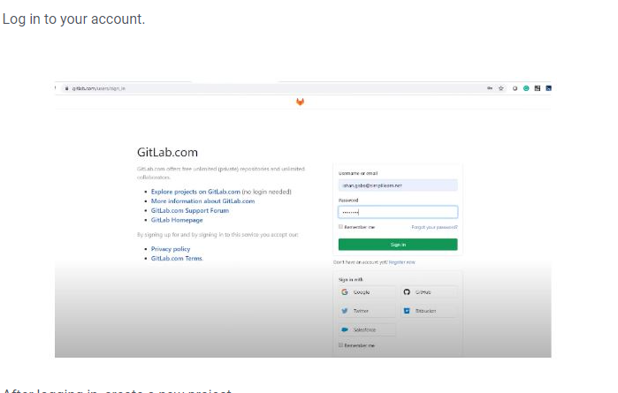
Push project from Local System to GitHub

Slide 44
Working with Django Heroku
How to Deploy Django application on Heroku ?
Django is an MVT web framework used to build web applications. It is robust, simple, and helps web developers to write clean, efficient, and powerful code. In this lecture, we will learn how to deploy a Django project on Heroku in simple steps. For this, a Django project should be ready.
Heroku account
1. Install your Heroku toolbelt which you can find here: https://toolbelt.heroku.com
2. Authenticate your Heroku account either running the below command in cmd or gitbash
$heroku login

Slide 45
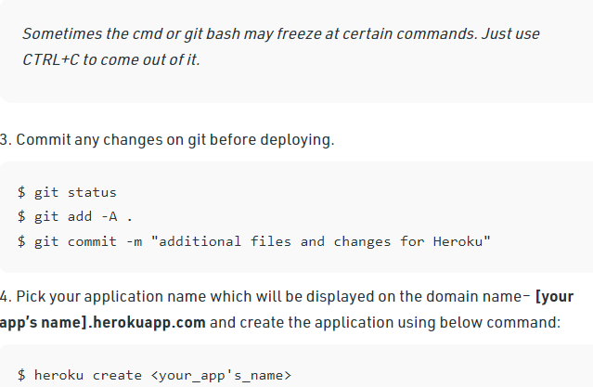
Working with Django Heroku

Slide 46
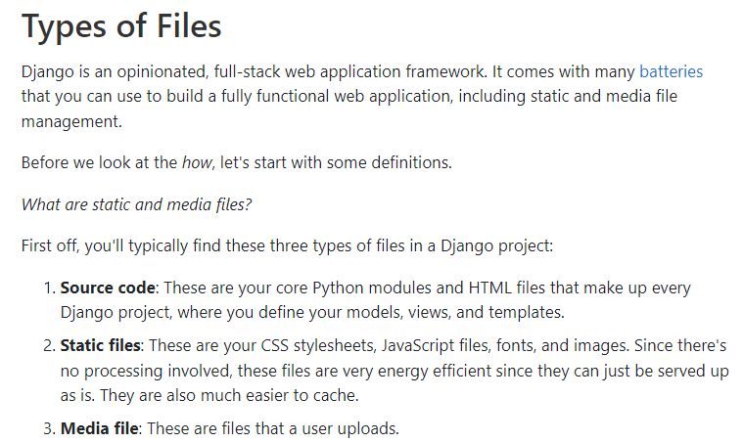
Working with Static Root

Slide 47
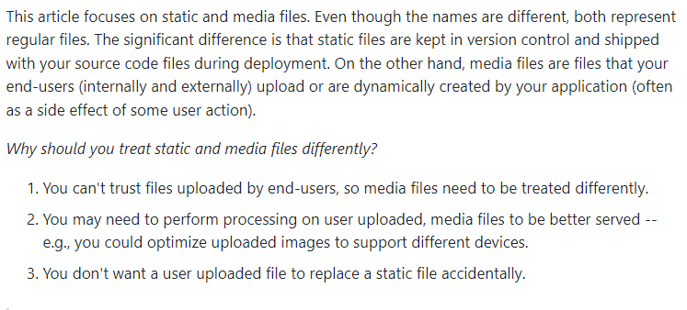
Working with Static Root

Slide 48
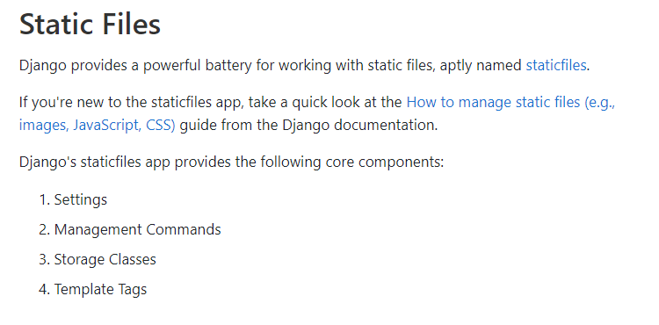
Working with Static Root

Slide 49
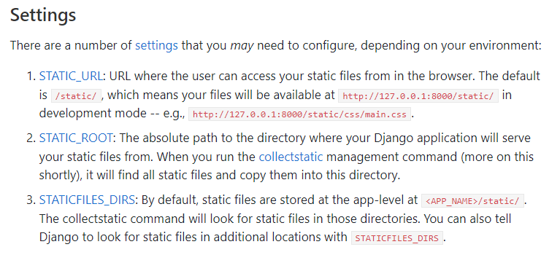
Working with Static Root

Slide 50
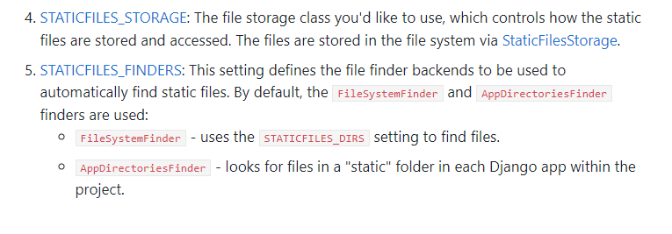
Working with Static Root

Slide 51
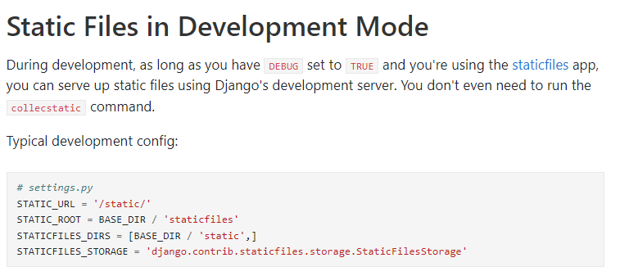
Working with Static Root

Slide 52
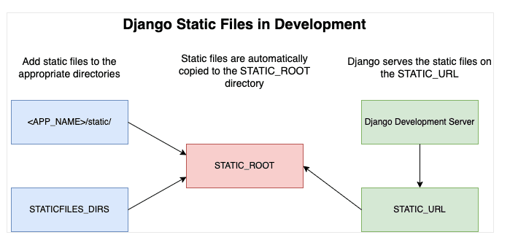
Working with Static Root

Slide 53
Handling WSGI with gunicorn
Gunicorn - WSGI server:-
Gunicorn ‘Green Unicorn’ is a Python WSGI HTTP Server for UNIX. It’s a pre-fork worker model ported from Ruby’s Unicorn project. The Gunicorn server is broadly compatible with various web frameworks, simply implemented, light on server resources, and fairly speedy.
Features
Natively supports WSGI, Django, and Paster
Automatic worker process management
Simple Python configuration
Multiple worker configurations
Various server hooks for extensibility
Compatible with Python 3.x >= 3.5

Slide 54
Handling WSGI with gunicorn
Gunicorn is a stand-alone WSGI web application server which offers a lot of functionality. It natively supports various frameworks with its adapters, making it an extremely easy to use drop-in replacement for many development servers that are used during development.
Technically, the way Gunicorn works is very similar to the successful Unicorn web server for Ruby applications. They both use what’s referred to as the pre-fork model. This, in essence, tasks the central [Gunicorn] master process to handle the management of workers, creation of sockets and bindings, etc.
Nginx is a very high performant web server / (reverse)-proxy. It has reached its current popularity due to being light weight, relatively easy to work with, and easy to extend (with add-ons / plug-ins).

Slide 55
Setting up Database & adding users
There are several ways to extend the the default Django User model. Perhaps one of the most common way (and also less intrusive) is to extend the User model using a one-to-one link.
This strategy is also known as User Profile. One of the challenges of this particular strategy, if you are using Django Admin, is how to display the profile data in the User edit page. And that’s what this tutorial is about.
Then a very important thing, we need to override the get_inline_instances method, so to display the inlines only in the edit form. Otherwise we might get some problems because of how the Signals work. Remember that the Signal is responsible for creating the Profile instance.

Slide 56
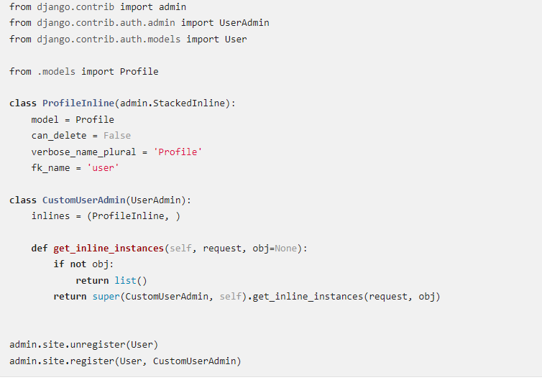
Setting up Database & adding users

Slide 57
Daily Quiz
Discuss Four Important Pillars to website.
What is the role of frameworks in python.
Discuss any three frameworks.
What is Heroku, explain its architecture.
Discuss WSGI .
Explain gunicorn .
Discuss the role of Git .
Discuss the architecture of Git.
Discuss about the Request Http methods in Python.
Discuss about Flask application.

Slide 58
Daily Quiz
11. How can you combine multiple Query Sets in a View?
12. How to obtain the SQL query from the query set?
13. Discuss any three frameworks.
14. What is Heroku, explain its architecture.
15. Discuss WSGI .
16. Explain gunicorn .
17. Discuss the role of Git .
18. Discuss the architecture of Git.
19. Discuss about the Request Http methods in Python.
20. Discuss about Flask application.

Slide 59
Weekly Assignment
What are the most important pillar of website .
What are the disadvantages of Django?
What are the different data types used in Django.
What are the salient features of Django.
What are some of the technical features that Django includes

Slide 60
Weekly Assignment
6. Name some Companies that use Django.
7. What are the disadvantages of Django?
8. What are the different data types used in Django.
9. What are the salient features of Django.
10. What are some of the technical features that Django includes

Slide 61
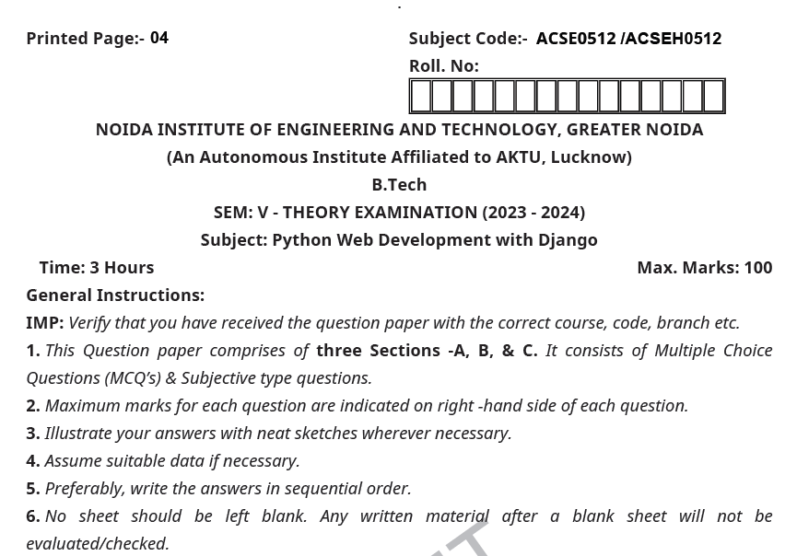
OLD University Exam Question Paper

Slide 62
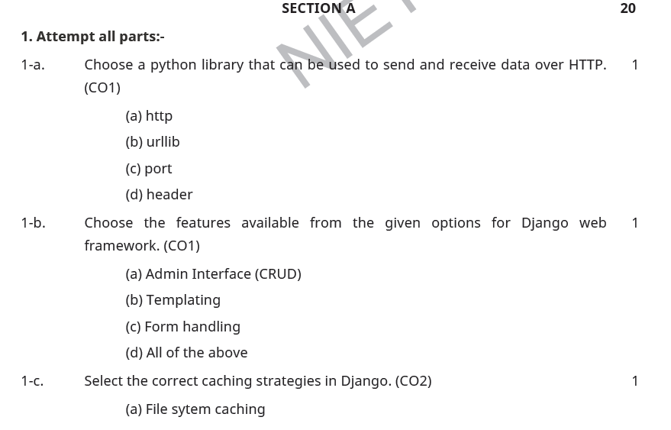
OLD University Exam Question Paper

Slide 63
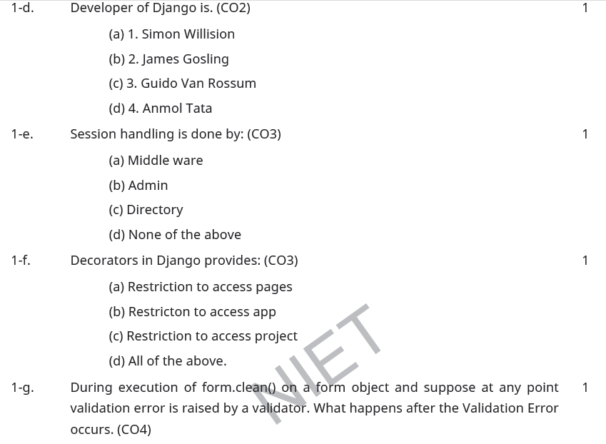
OLD University Exam Question Paper

Slide 64
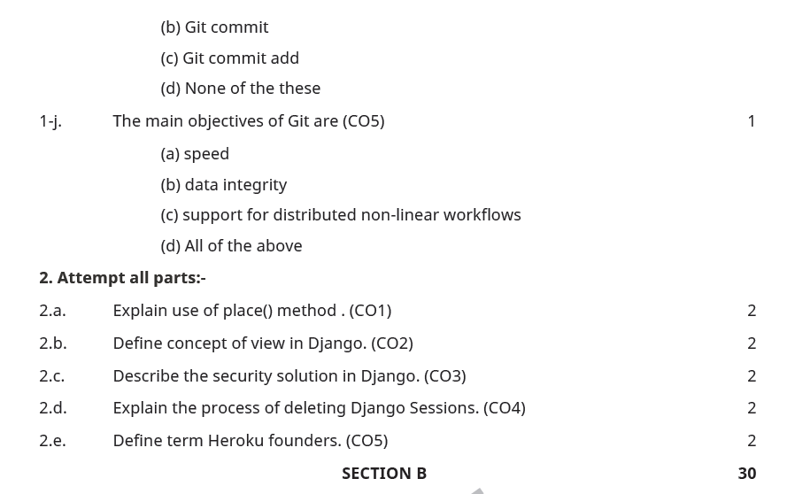
OLD University Exam Question Paper

Slide 65
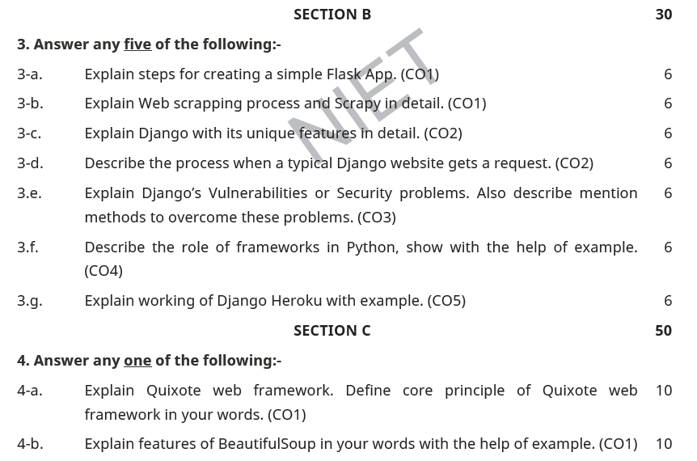
OLD University Exam Question Paper

Slide 66
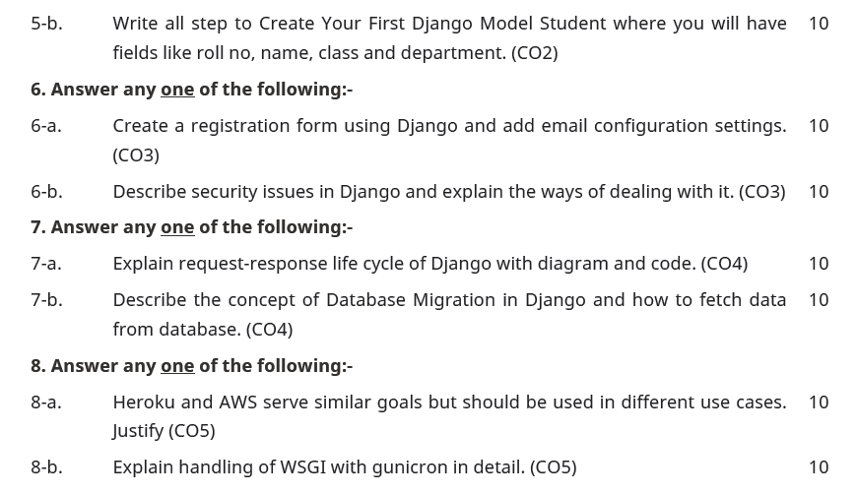
OLD University Exam Question Paper

Slide 67
Recap of Unit
Gunicorn is a stand-alone WSGI web application server which offers a lot of functionality. It natively supports various frameworks with its adapters, making it an extremely easy to use drop-in replacement for many development servers that are used during development.
This strategy is also known as User Profile. One of the challenges of this particular strategy, if you are using Django Admin, is how to display the profile data in the User edit page. And that’s what this tutorial is about.
Then a very important thing, we need to override the get_inline_instances method, so to display the inlines only in the edit form. Otherwise we might get some problems because of how the Signals work. Remember that the Signal is responsible for creating the Profile instance.

Slide 68
Topic Link ( YouTube & NPTEL Video Links)
YouTube /other Video Links
https://youtu.be/eoPsX7MKfe8?list=PLIdgECt554OVFKXRpo_kuI0XpUQKk0ycO
https://youtu.be/tA42nHmmEKw?list=PLh2mXjKcTPSACrQxPM2_1Ojus5HX88ht7
https://youtu.be/8ndsDXohLMQ?list=PLDsnL5pk7-N_9oy2RN4A65Z-PEnvtc7rf
https://youtu.be/QXeEoD0pB3E?list=PLsyeobzWxl7poL9JTVyndKe62ieoN-MZ3
https://youtu.be/9MmC_uGjBsM?list=PL3pGy4HtqwD02GVgM96-V0sq4_DSinqvf

Slide 69
MCQ s
1. What is a Django App? ADjango app is an extended package with base package is Django B. Django app is a python package with its own components. C. Both 1 & 2 Option D. All of the above | 2. Django was introduced by A. Adrian Holovaty B. Bill Gates C. Rasmus Lerdorf D. Tim Berners-Lee
3. What are Migrations in Django A. They are files saved in migrations directory. B. They are created when you run make migrations command. C. Migrations are files where Django stores changes to your models. D. All of the above
4. Which architectural pattern does django follow APHP B. MVT C. HTML D. None of the above

Slide 70
MCQ s
which of these is not a valid backend for caching in django
A. Django.core.cache.backends.sys.memory
B. django.core.cache.backends.db.DatabaseCache
C. django.core.cache.backends.locmem.LocMemCache
D. None of the above
5. Which architectural pattern does django follow
A.PHP
B. MVT
C. HTML
D. None of the above

Slide 71
MCQ s
6. Python is a : Development environment Set of editing tools Programming Language | Python is Case Sensitive when dealing with Identifiers? Yes No Sometimes Only None Of the Above
What is the OUTPUT of the following Statement? print 0xA + 0xB + 0xC : 0xA0xB0xC 33 ABC 000XXXABC | What is the OUTPUT when the following Statement is executed? “abc”+”xyz” abc abcxyz abcz abcxy
what is the type of a? a={1,2:3} list set dict syntax error

Slide 72
Glossary Questions
Top 10 Django interview questions
Explain Django Architecture?
Explain the Django project directory structure?
What are models in Django?
What are templates in Django or Django template language?
What are views in Django?
What is Django ORM?
What is Django Rest Framework(DRF)?
What is the difference between a project and an app in Django?
What are different model inheritance styles in the Django?
What are Django Signals?

Slide 73
Expected Questions for University Exam
Top 10 Django interview questions
Explain Django Architecture?
Explain the Django project directory structure?
What are models in Django?
What are templates in Django or Django template language?
What are views in Django?
What is Django ORM?
What is Django Rest Framework(DRF)?
What is the difference between a project and an app in Django?
What are different model inheritance styles in the Django?
What are Django Signals?

Slide 74
Summary
Till Now we understand The idea of Having a website helps grow an online presence, whether that be your personal blog or business, by connecting you with a broader audience. A website can also become a platform for sharing your opinions and skills, creating opportunities for personal or work-related projects.
Four Important Pillars to Deploy i.e Technology, UX and usability ,conversation and Retention. Django is an MVT web framework used to build web applications. It is robust, simple, and helps web developers to write clean, efficient, and powerful code. In this lecture, we will learn how to deploy a Django project on Heroku in simple steps. GitHub is an increasingly popular programming resource used for code sharing. It's a social networking site for programmers that many companies and organizations use to facilitate project management and collaboration.

Slide 75
References
(1) Tom Aratyn, “Building Django 2.0 Web Applications: Create enterprise-grade, scalable Python web applications easily with Django 2.0”, 2nd Edition 2018, Packt Publishing.
(2) Nigel George, “Build a website with Django”, 1st Edition 2019, GNW Independent Publishing Edition.
(3) Ray Yao,” Django in 8 Hours: For Beginners, Learn Coding Fast!, 2nd Edition 2020, Independently published Edition.
(4) Harry Percival, “Test-Driven Development with Python: Obey the Testing Goat: Using Django, Selenium, and JavaScript”, 2nd Edition 2019, Kindle Edition.

Slide 76
THANK YOU

